Slide 1
Module-1
Introduction to Automata Theory

Slide 2
Models of Computation

Slide 3
Computation
CPU
memory

Slide 4
temporary memory
input memory
CPU
output memory
Program memory

Slide 5
Example:
temporary memory
input memory
CPU
output memory
Program memory
compute
compute

Slide 6
temporary memory
input memory
CPU
output memory
Program memory
compute
compute

Slide 7
temporary memory
input memory
CPU
output memory
Program memory
compute
compute

Slide 8
temporary memory
input memory
CPU
Program memory
output memory
compute
compute

Slide 9
Automata theory is the study of abstract machines and automata.
The computational problems can be solved using them.
It is a theory in theoretical computer science and discrete mathematics

Slide 10
Automaton
temporary memory
Automaton
input memory
CPU
output memory
Program memory

Slide 11
Different Kinds of Automata
Automata are distinguished by the temporary memory
Finite Automata: no temporary memory
Pushdown Automata: stack
Turing Machines: random access memory

Slide 12
Finite Automaton
temporary memory
Finite
Automaton
input memory
output memory
Example: Vending Machines (small computing power)

Slide 13
Pushdown Automaton
Stack
Push, Pop
Pushdown
Automaton
input memory
output memory
Example: Compilers for Programming Languages
(medium computing power)

Slide 14
Turing Machine
Random Access Memory
input memory
Turing
Machine
output memory
Examples: Any Algorithm (highest computing power)

Slide 15
Power of Automata
Finite
Automata
Pushdown
Automata
Turing
Machine
Less power
Solve more
computational problems
More power

Slide 16
Applications of finite automata
For the designing of lexical analysis of a compiler which breaks the input text into logical units like identifiers, keywords etc.
For recognizing the pattern using regular expressions.
For the designing of the combination and sequential circuits.
Software for designing and checking the behavior of digital circuits.
Used in text editors.
For the implementation of spell checkers.
Software for scanning large bodies of text like web pages to find occurrence of words, phrases and other patterns.
Software to verify all types that have finite number of distinct states such as communications protocols for secure exchange of information.

Slide 17
Applications of Push Down Automata
For designing the parsing phase of a compiler (Syntax Analysis).
For implementation of stack applications.
For evaluating the arithmetic expressions.
For solving the Tower of Hanoi Problem.

Slide 18
Applications of Turing machine
For solving any recursively enumerable problem.
For understanding complexity theory.
For implementation of neural networks.
For implementation of Robotics Applications.
For implementation of artificial intelligence.

Slide 19
Basic Definitions
Three fundamental concepts used in Automata theory are:
Languages
Grammars
Automata

Slide 20
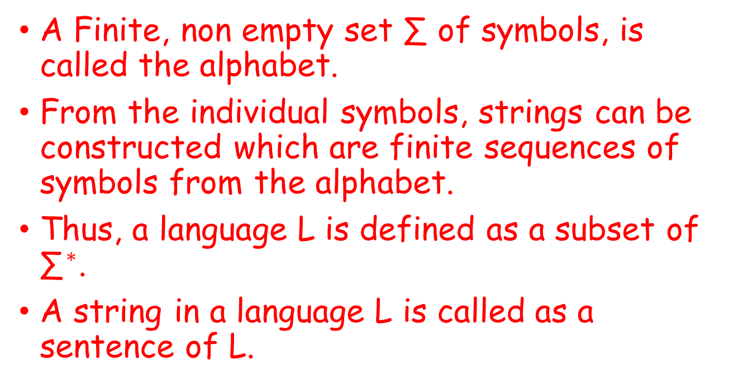
Languages
A Finite, non empty set ∑ of symbols, is called the alphabet.
From the individual symbols, strings can be constructed which are finite sequences of symbols from the alphabet.
Thus, a language L is defined as a subset of ${\text{∑}}^{∗}$.
A string in a language L is called as a sentence of L.

Slide 21
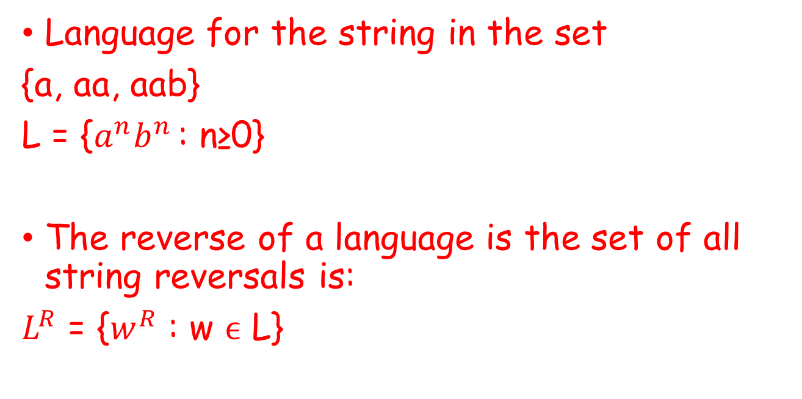
Example:
Language for the string in the set
{a, aa, aab}
L = {$a^{n}b^{n }$: n≥0}
The reverse of a language is the set of all string reversals is:
$L^{R}$ = {$w^{R}$ : w ϵ L}

Slide 22
Grammars
A grammar G is defined as a quadruple that consists of finite set of variables, terminal symbols, start variable and finite set of productions.
Example: S→ aAb | λ

Slide 23


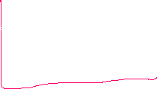
Automata
An automata is an abstract model of a digital computer and has the mechanism for reading input. It also has input as a string over a given alphabet written in an input file.

Slide 24
General Concepts of Automata Theory
Symbol
Alphabet
Strings
Empty Strings
Length of the string
Power of an Alphabet
Concatenation of two strings
Languages

Slide 25
Alphabets and Strings
Symbol: a, b, 1 ,2, 3, 0, etc.
We will use small alphabets:
Strings

Slide 26
String Operations
1. Concatenation

Slide 27
2.Reverse
3. String Length
Examples:
Length:

Slide 28
4. Length of Concatenation
Example:

Slide 29
5. Empty String
A string with no letters: or ϵ
Observations:

Slide 30
6. Substring
Substring of string:
a subsequence of consecutive characters
String Substring

Slide 31
7. Prefix and Suffix
Prefixes Suffixes
prefix
suffix

Slide 32
8. Another Operation
Example:
Definition:

Slide 33
9. The * Operation
the set of all possible strings from alphabet

Slide 34
10. The + Operation
: the set of all possible strings from
alphabet except

Slide 35
Languages
A language is a set of strings
String: A sequence of letters
Examples: “cat”, “dog”, “house”, …
Defined over an alphabet:

Slide 36
A language is any subset of
Example:
Languages:

Slide 37
Note that
Sets
Set size
Set size
String length

Slide 38
Another Example
An infinite language

Slide 39
Operations on Languages
1. The usual set operations
Complement:

Slide 40
2. Reverse
Definition:
Examples:

Slide 41
3.Concatenation
Definition:
Example:

Slide 42
4. Another Operation
Definition:
Special case:

Slide 43
More Examples

Slide 44
5. Star-Closure (Kleene *)
Definition:
Example:

Slide 45
6. Positive Closure (Kleene Plus)
Definition:

